Slide 1
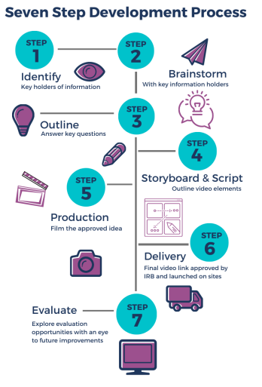
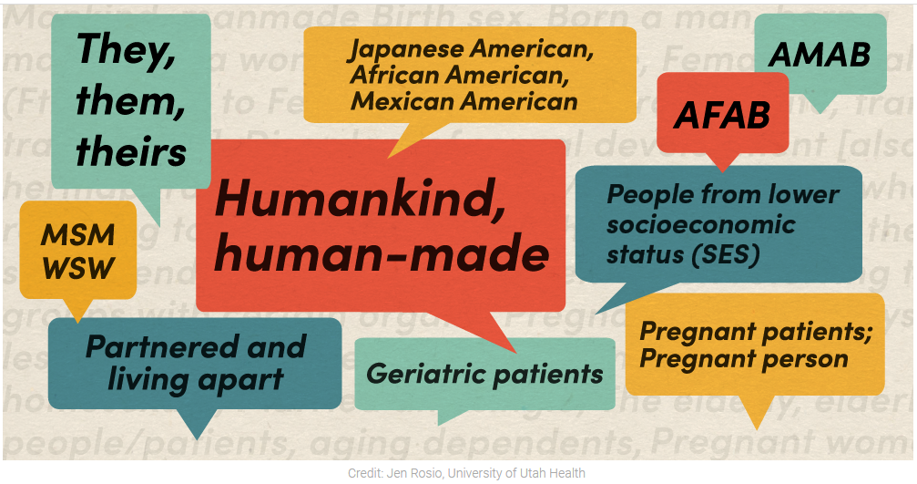
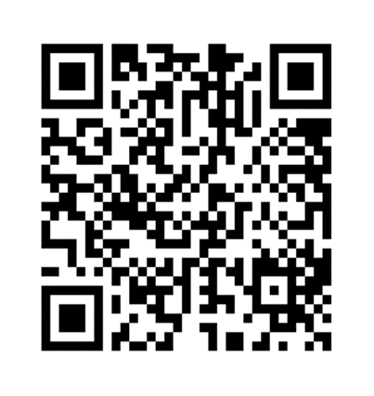
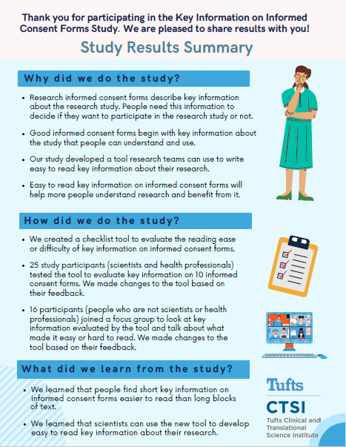
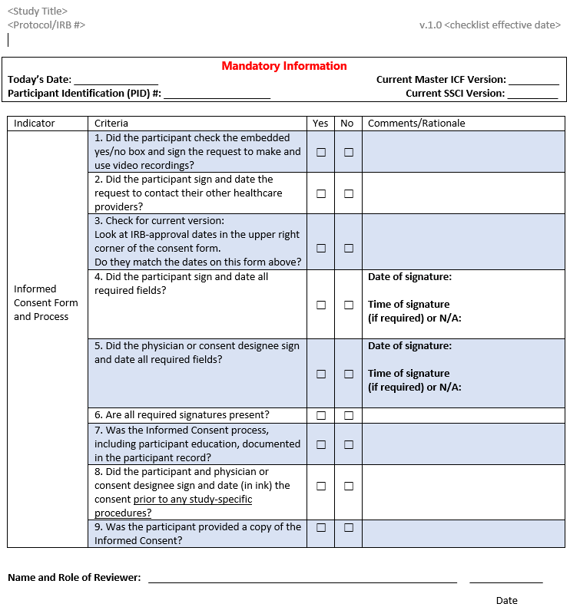
Tools and Resources to Support the use of Plain Language and Inclusive Approaches in the Informed Consent Process: An Informed Consent Toolkit
Marisha Palm, Jeri Burr, Mary Bailey, Jordyn Carll, Natalie Dilts, Kim Friedman Landau, Colleen Lawrence, Vincent Miller, Shawn Steidinger, Mary Stroud, Cortney Wieber, Sabrina Kurtz-Rossi
Background
Download from the TIN Website
Improving Accessibility
Informed Consent Concise Summary Template
Interactive Consent (iConsent)
Quick Guide to Inclusive Language
It is Smarter to Be Understood guide for developing study materials
Developing a Clinical Trial Informational Video
Readability, Understandability, and Actionability of Key Information (RUAKI) Indicator
RIC Recruitment& Retention Toolkit Materials Content + Design Toolkit
Informed consent is the process by which a potential research participant is informed about the study being conducted so that they can decide whether or not to take part.
It is an ethical and legal requirement for research with human subjects; however, there are challenges that result in a participant not being able to make an informed decision, including a study team’s ineffective communication and failure to consider cultural issues.
Research teams working to improve the Informed Consent process from across the Trial Innovation Network (TIN), a group of academic organizations supporting clinical research, formed a working group to:
Discuss challenges and successes to making informed consent more accessible to research participants, especially those in underrepresented groups
Share tools and resources their organizations had developed to improve the informed consent process and participant experience
Develop a toolkit for investigators, study coordinators, and others working with potential research participant to improve their informed consent practices
The toolkit is publicly available on the Trial Innovation Network (TIN) website for download
What is included in the toolkit?
Navigation Categories
TIN Working Group Resources There are 16 informed consent resources that each have summary pages and accompanying materials
Global Resources Two resources that provide information that could be helpful particularly for those who work with international organizations or participants
National Resources A compilation of resources from HHS, NIH, CDC and other national organizations that offer guidance, toolkits, and templates
Health Literacy Resources Templates and resources to support applying health literacy tools to informed consent
Literature Collection Resources Peer-reviewed publications related to informed consent practices and processes
The resources in the toolkit have been organized into the color-coded categories below.
Improving Accessibility
Special Population Considerations
Supporting Consent Operations
Broad Consent (lit collection only)
Special Population Considerations
Faster Together, Enhancing the Recruitment of Minorities in Clinical Trials
Plain Language Informed Consent Forms and Processes to Promote Empowered Decision Making for People Underrepresented in Research
Pediatric Informed Consent
Using a multicultural and multilingual awareness-raising strategy to enhance enrollment of racially underrepresented minoritized communities – the PASSITON trial
Acknowledgements
Supporting Informed Consent Operations
Community Engaged Informed Consent Training for Clinical Research Staff
Consent Builder
RedCAP-based eConsent
SIRB Two-Part Informed Consent Model
SIRB Two-Part Informed Consent Checklist
We would like to acknowledge the TIN Single IRB Work Group for their support of the work conducted by the Informed Consent Work Group.
We would also like to acknowledge Cecilia Pessoa-Gingerich and Emily Bartlett at Johns Hopkins University for their graphic design assistance, and Shawn Steidinger from the University of Utah for her help with the environmental scan.

